Slide 1
Leading in an AI World
Stephanie Beben Chief Technologist, Data Scientist, Booz Allen Hamilton
March 2018

Slide 2
What does it mean to lead in an AI world?

Slide 3
Leading the Competition
Leading the Organization
Leading the State of the Art

Slide 4
Leading the Competition
Leading the Organization
Leading the State of the Art

Slide 5
4,178
Source: Angel.co
Notes:
https://angel.co/artificial-intelligence

Slide 6
$93.7b
Source: Recode
Notes:
https://www.recode.net/2017/9/1/16236506/tech-amazon-apple-gdp-spending-productivity

Slide 7
42%
Source: CBInsights
Notes:
https://www.cbinsights.com/research/top-acquirers-ai-startups-ma-timeline/

Slide 8
$31b
Source: SCMP
Notes:
https://www.recode.net/2017/9/1/16236506/tech-amazon-apple-gdp-spending-productivity

Slide 9
Facts tell… Stories sell

Slide 10
Strategy makes a difference
Credit: Tesla
Credit: Google

Slide 11
Fill a labor shortage or launch a 2nd career
Credit: OTTO

Slide 12
Create new knowledge
Credit: University of Manchester

Slide 13
Leading the Competition
Leading the Organization
Leading the State of the Art

Slide 14
LESSONS TO FOLLOW
Complexity is a boon, not a burden
The machine works better than the gut
Machine models top mental models
Solutions don't require logic
Create value by giving it away
Breakthrough without experience
Perfect launches lose to imperfect ones

Slide 15
Strategy makes a difference
Credit: NASA

Slide 16
Create operational efficiencies

Slide 17
Don't rely on a single model

Slide 18
Leading the Competition
Leading the Organization
Leading the State of the Art

Slide 19
LEARNING IS THE FOUNDATION TO HUMAN INTELLIGENCE... AND MACHINE INTELLIGENCE
HOW DO PEOPLE LEARN?
DIRECT
INDIRECT
Facts and specific details that you retain in various methods...
Experiences you must have on your own to retain...
Washington DC is the capital of the US
More than half of the coastline of the entire United States is in Alaska
Balancing on a bicycle
Pronunciation of a foreign language
Moving between deductive and inductive reasoning during the learning cycle is a learning technique used by humans and machines
Source: UMD Cognitive Neurosciences, Booz Allen Analysis.
There are other forms of learning, this is a summary for context setting

Slide 20
MACHINES LEARN VERY DIFFERENTLY THAN HUMANS
Machines learn in five key ways:
Fill in gaps in existing knowledge
Emulate the human brain
Simulate evolution over many generations
Systematically reduce uncertainty
Notice similarities or differences between old and new
Source: The Master Algorithm, Booz Allen Analysis.

Slide 21
INGENIOUS HUMANS VS INTELLIGENT MACHINES
“AI is both closer and farther off than we imagine”
-- Mark Zuckerberg, Founder & CEO, Facebook
Today, machines can outpace humans on complex tasks, while a three-year old child can intuitively understand a scenario that even the most advanced MI cannot comprehend
MACHINE INTELLIGENCE CAN…
MACHINE INTELLIGENCE CANNOT…
Respond to human commands
Drive down a major highway
Select the best treatments for disease
Write poems, music, and artwork
Learn human tastes, preferences
Outperform humans at strategy games
Learn to perform narrow tasks better than humans
Speak conversationally about just any topic you choose
Drive in cities or bad weather
Develop new treatments independently
Create art that is better than humans'
Understand human emotion, humor
Invent new games to play
Teach itself new skills independently

Slide 22
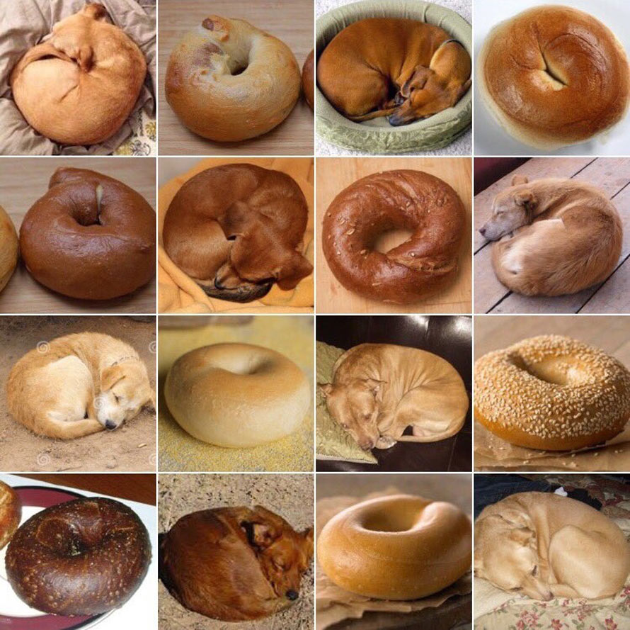
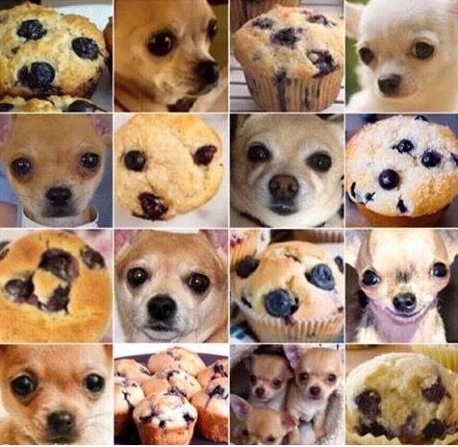
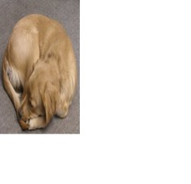
we've made advances, but we have a ways to go

Slide 23
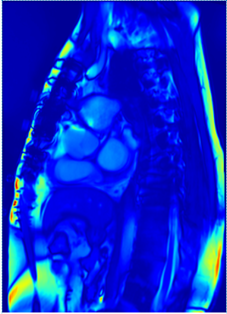
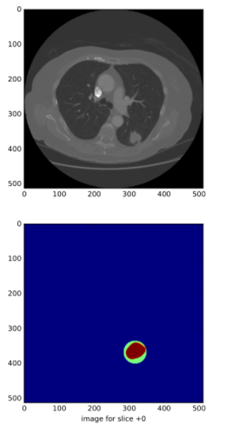
ADVANCES IN THE STATE OF THE ART
Image source: OPENi, Fox News Video

Slide 24
What could go wrong?

Slide 25
NOT ACCOUNTING FOR…
NOT BROAD ENOUGH DATA TRAINING SET

Slide 26
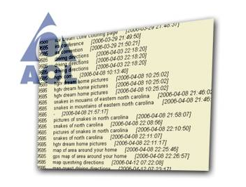
DATA THAT'S NOT ANONYMIZED
NOT ACCOUNTING FOR…

Slide 27
MACHINE BIAS
NOT ACCOUNTING FOR…

Slide 28
MAKING DECISIONS SOLELY BY INFERENCE
NOT ACCOUNTING FOR…

Slide 29
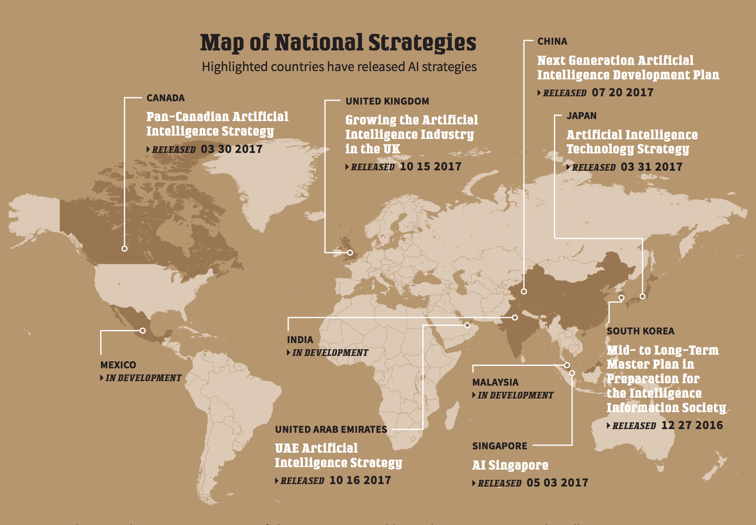
MAKING DECISIONS SOLELY BY INFERENCE
www.boozallen.com/machineintelligence

Slide 30
So, what now?

Slide 31
Take action
Fight the hype and negativity
Change your culture or find one that works
Find purpose in the work you do

Slide 32
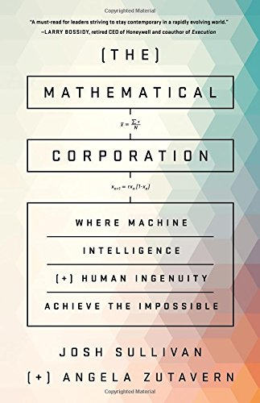
Join the conversation
www.boozallen.com/machineintelligence
@BoozDataScience

